Slide 1
OPTICAL CHARACTER RECOGNITION
Sreeparvathy V S
B.Tech 2nd year(IT)
Sri Manakula Vinayagar Engineering College

Slide 2
Technical Pool
Python 3.8.8( Image processing)
HTML CSS (Front end)
Django server for the transfer of data between front end and backend
Easyocr : Open source library for text recognition which when used returns the coordinates of the text, the text itself and the accuracy

Slide 3
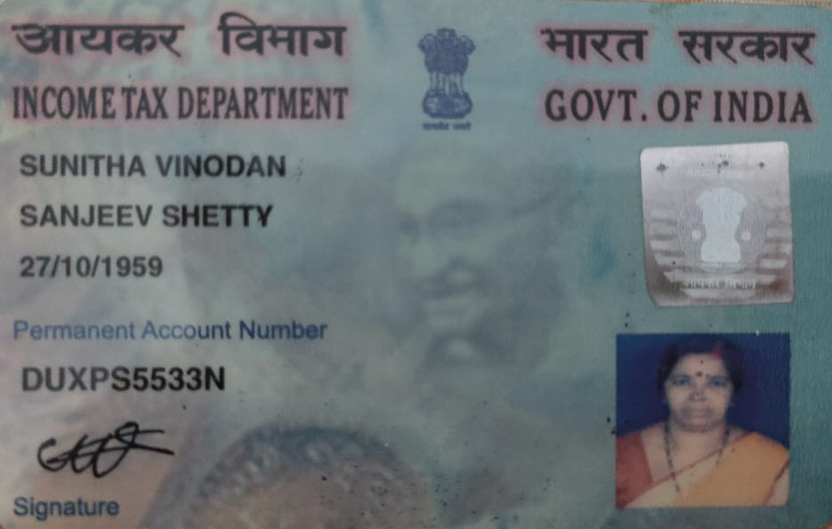
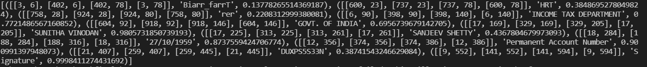
Easyocr
Input:

Slide 4
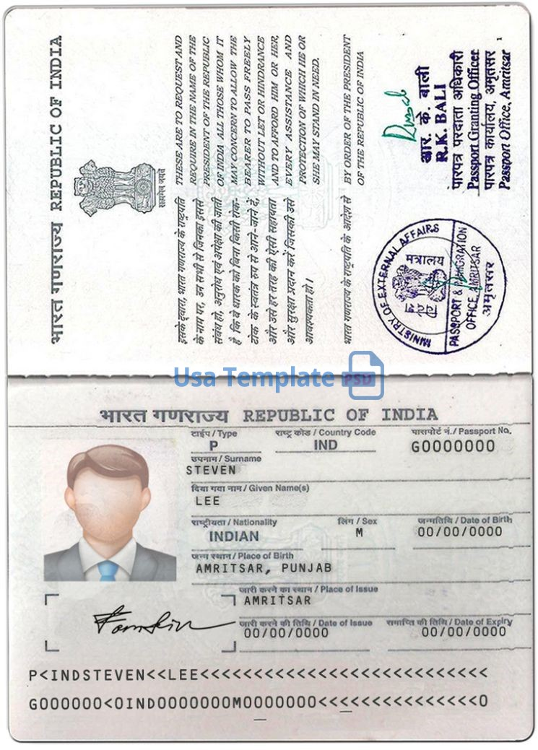
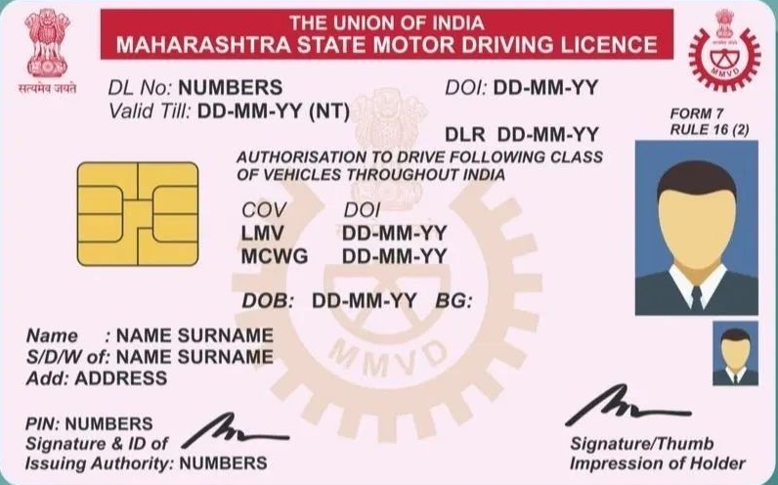
My Approach
Using certain keywords which are unique to those documents, easily able to identify the given document

Slide 5
FINDING THE ATTRIBUTES
01
02
The next element of the attribute will give its value
Compare the attributes with the ones present in the original

Slide 6
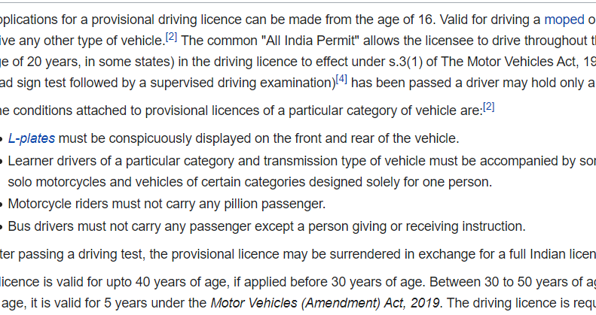
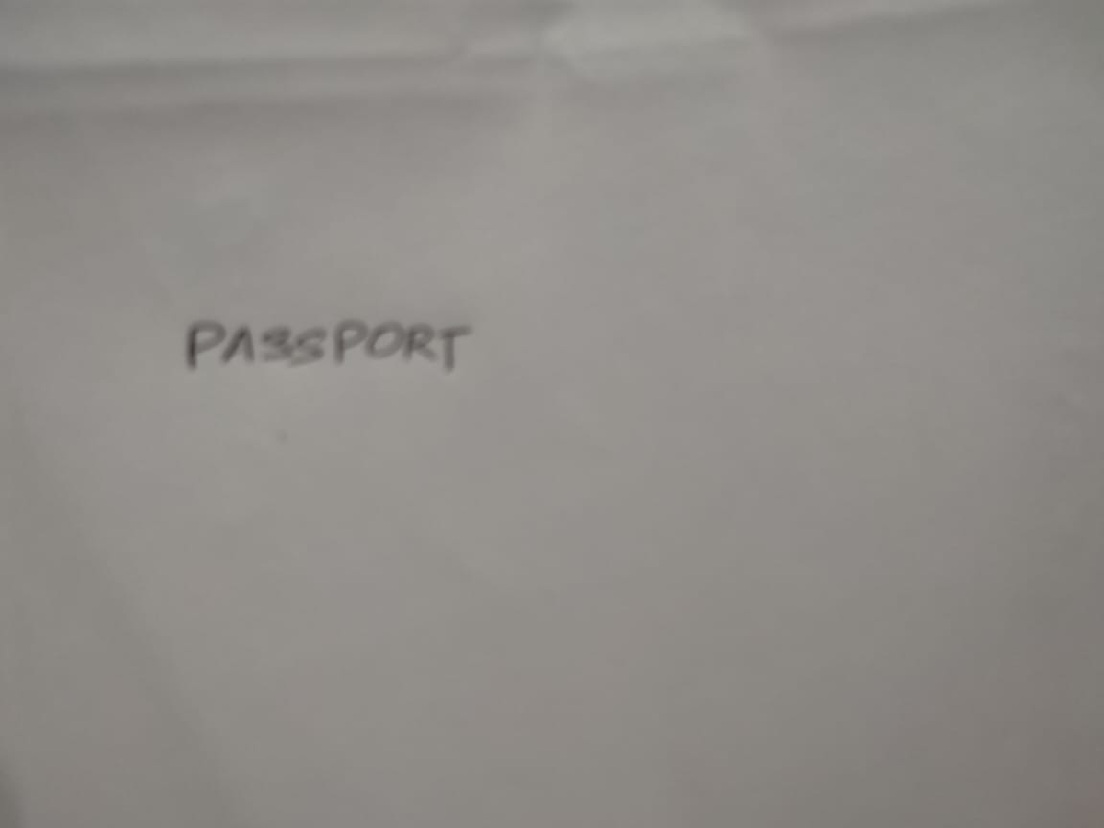
FINDING MISUSE
Initially checks for facial recognition
If number of words are less or more than a given threshold will not identify the documents
Number of words pass the maximum limit
No face recognized

Slide 7
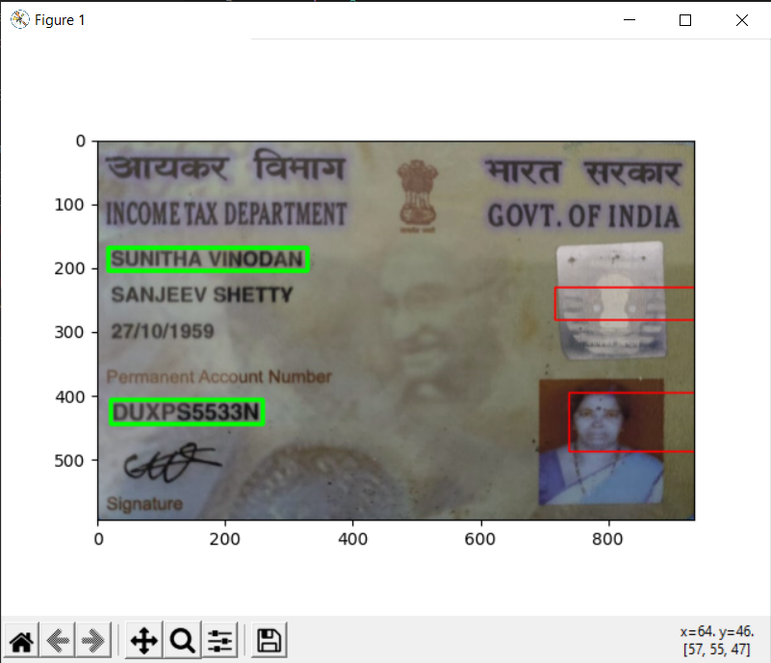
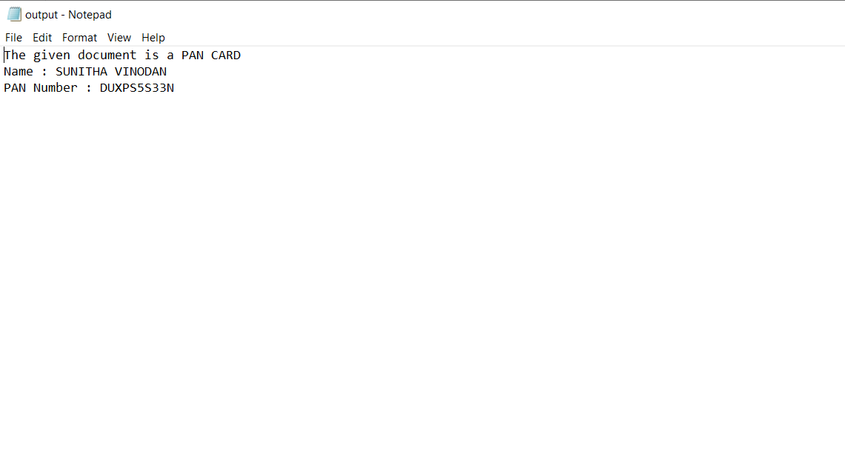
SAMPLE OUTPUT
The image has been identified as PAN Card and the attributes and their values have been identified

Slide 8
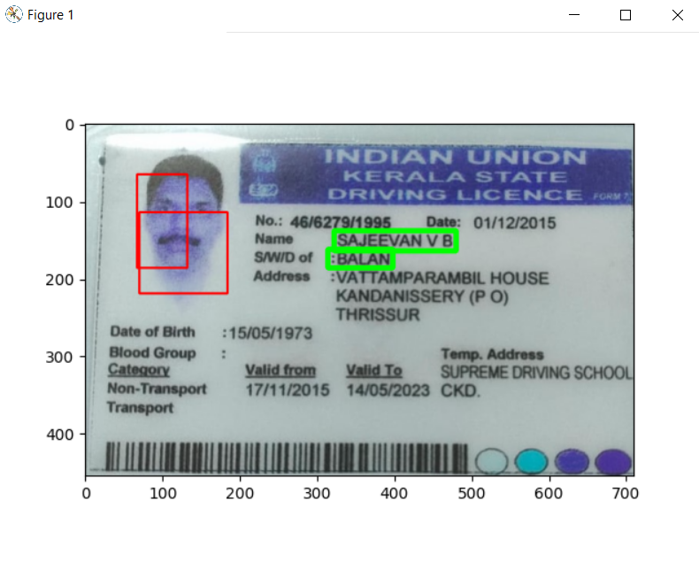
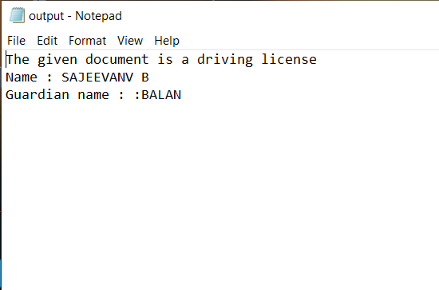
SOME OTHER EXAMPLES

Slide 9
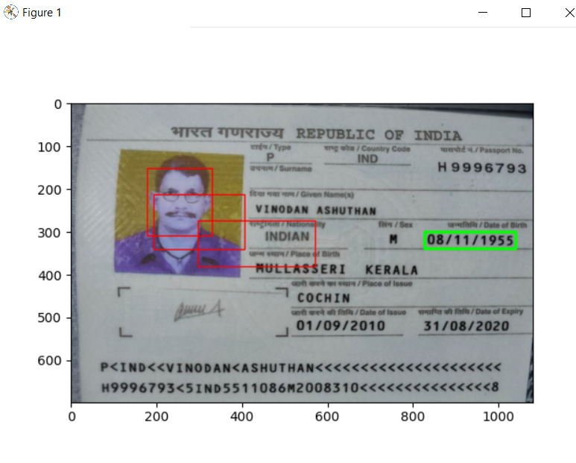
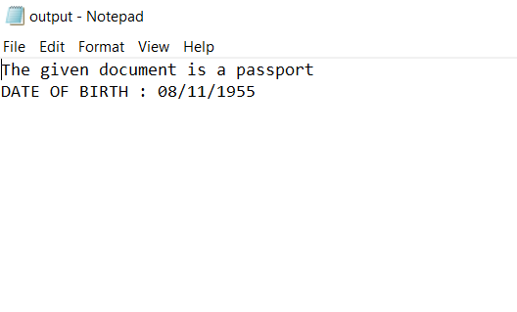
SOME OTHER EXAMPLES

Slide 10
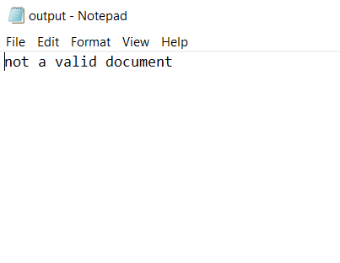

SOME OTHER EXAMPLES

Slide 11
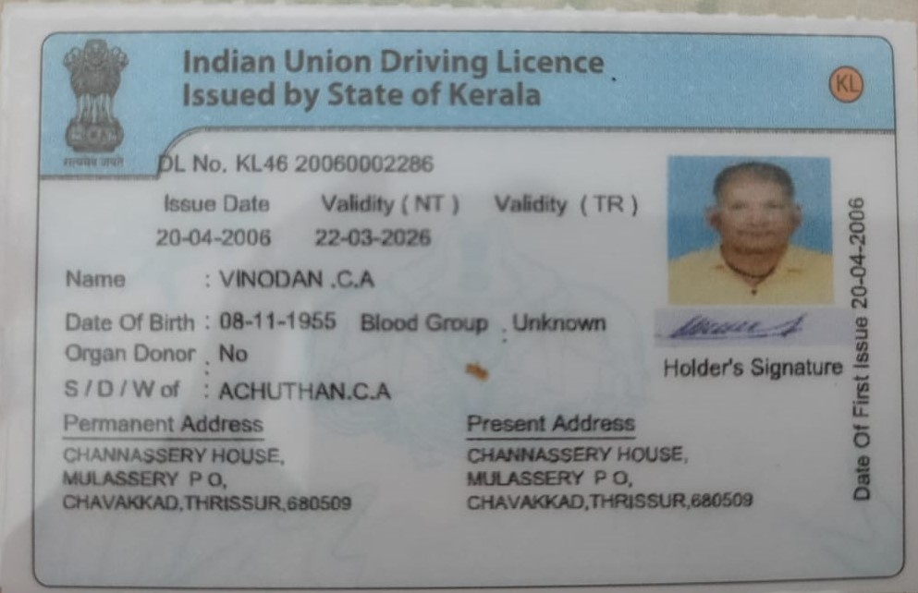
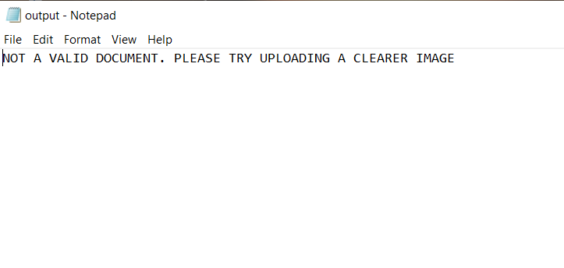
SOME OTHER EXAMPLES

Slide 12

FLOW

Slide 13
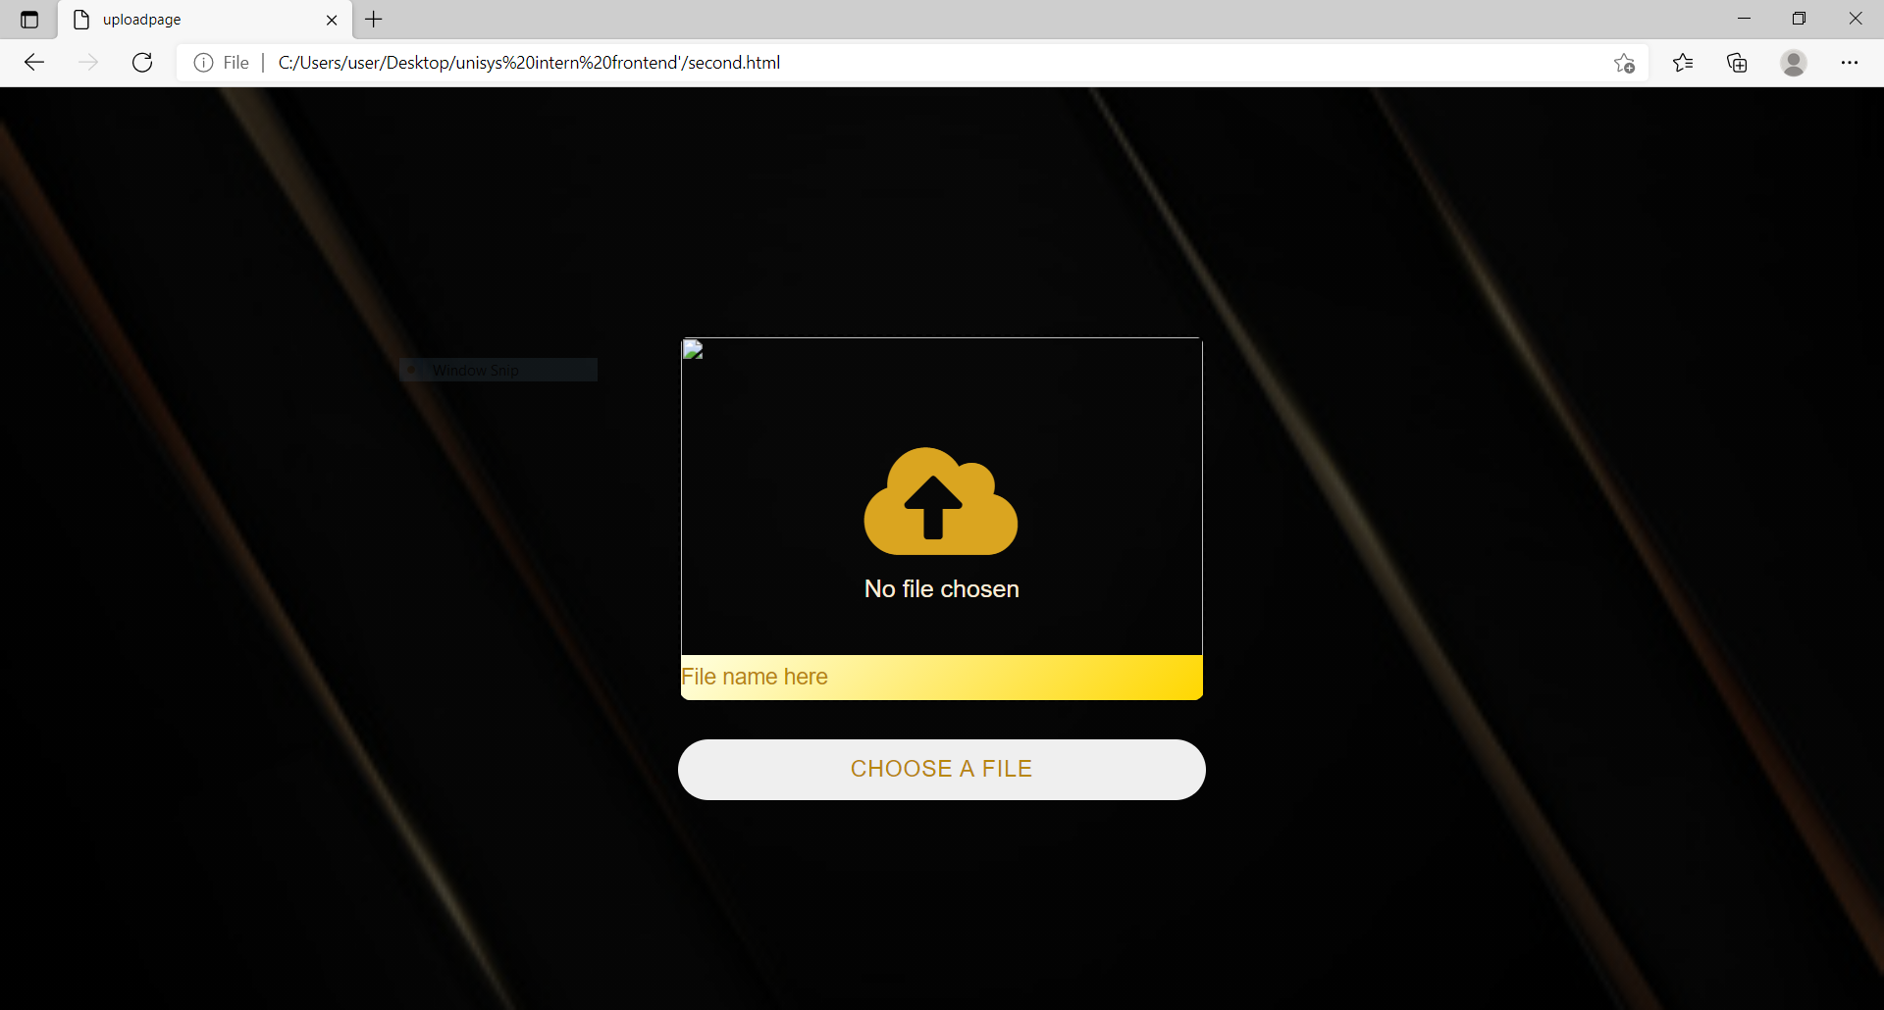
FLOW

Slide 14
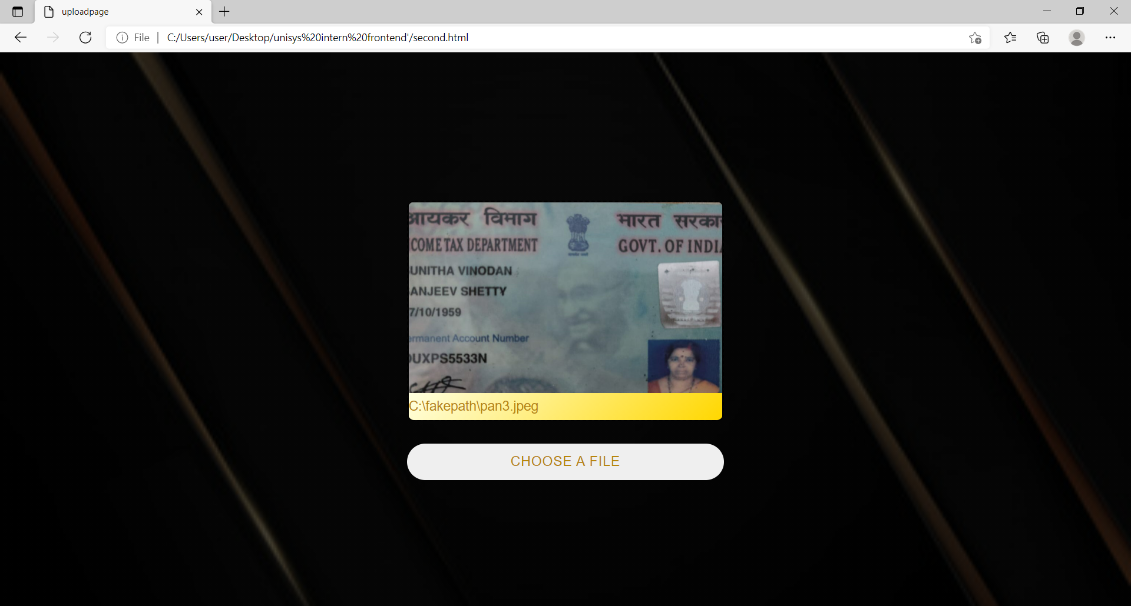
FLOW

Slide 15

FLOW

Slide 16
BENEFITS
Time saving for organizations with huge data
No need to manually fill the data
Digitilisation of data is always better
1
2
3
2
3

Slide 17
LIMITATIONS
Accuracy is less for now
The image has to be a clear one
Only few attributes identified in this version
1
2
3
2
3

Slide 18
FUTURE DEVELOPMENTS
MORE ACCURACY
MORE ATTRIBUTES IDENTIFIED
DATABASE

Slide 19
THANK YOU!

